Slide 1
Data wrangling
Section 6

Slide 2
Agenda
What is data wrangling
Cheat sheets hack

Slide 3
Data wrangling
we’ll introduce a series of functions from the dplyr package for data wrangling that will allow you to take a data frame and “wrangle” it (transform it) to suit your needs.
There is a further benefit to learning to use the dplyr package for data wrangling: its similarity to the database querying language SQL

Slide 4
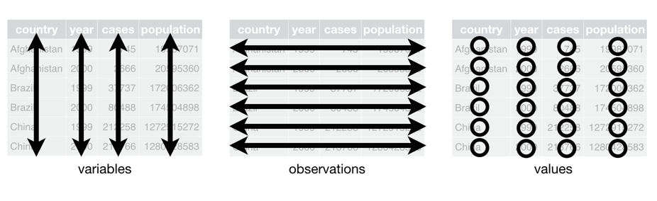
Data structure semanticcs
Notes:
Columns are called and treated as variables
While rows are treated and called observations

Slide 5
Installing dplyr packages
First before delving into the built in functions used for data wrangling we need to install and include the packages first using
> install.packages(“dplyr”)
> library(dplyr)

Slide 6
Special values to watch out for
NA: missing
  na.rm=TRUE available in many functions
  Also, see na.omit(), na.exclude(), na.fail(), na.pass()
NULL: null set
  Often used when something is undefined
Inf: infinite
NaN: Not a number. Result of an invalid computation, e.g., log(-1)
Warnings(): If R mentions a warning in data wrangling, make sure you've handled it or know its origin.

Slide 7
The pipe operator %>%
  Say you would like to perform a hypothetical sequence of operations on a hypothetical data frame x using hypothetical functions f(), g(), and h()You would read this sequence as: h(g(f(x)))
  Take x then
  Use this output as the input to the next function f() then
  Use this output as the input to the next function g() then
  Use this output as the input to the next function h()
      x %>%
      f() %>%
      g() %>%
      h()
Notes:
Say you would like to perform a hypothetical sequence of operations on a hypothetical data frame x using hypothetical functions f(), g(), and h():
Take x then
Use x as an input to a function f() then
Use the output of f(x) as an input to a function g() then
Use the output of g(f(x)) as an input to a function h()
One way to achieve this sequence of operations is by using nesting parentheses as follows: h(g(f(x)))

Slide 8
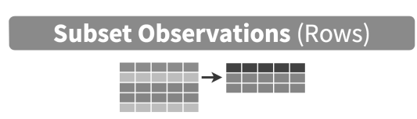
filter()
a data frame’s existing rows to only pick out a subset of them.
>portland_flights <- flights %>%
filter(dest == "PDX")
View(portland_flights)
Don’t forget that you can use the equality operators and logical operators

Slide 9
Hands on
I need to filter the data set of ChickWeight where the weight column is bigger than or equal 35 AND smaller than or equal 100
Notes:
xx<-ChickWeight %>% filter(weight>=35 & weight <=100)

Slide 10

summarize()
one or more of its columns/variables with a summary statistic. Examples of summary statistics include the mean, SD, median and interquartile range of temperatures as we saw in previous Sections

Slide 11
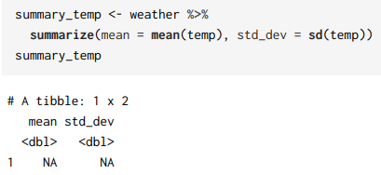
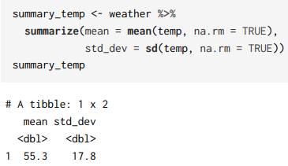
Example:

Slide 12
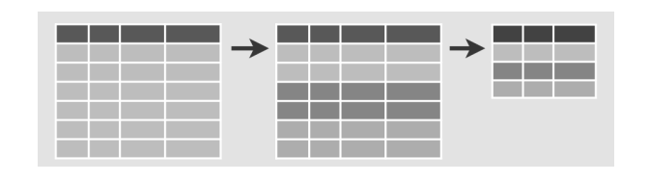
group_by()
its rows. In other words, assign different rows to be part of the same group. We can then combine group_by() with summarize() to report summary statistics for each group separately.

Slide 13
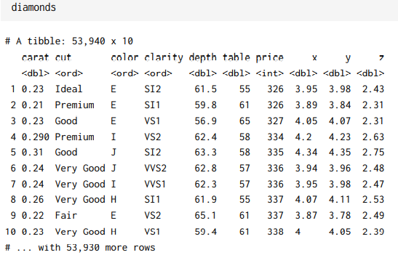
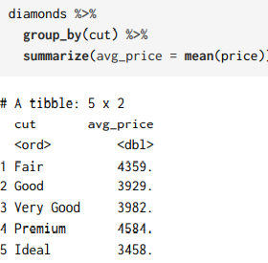
Example:

Slide 14


mutate()
its existing columns/variables to create new ones. For example, convert hourly temperature recordings from degrees Fahrenheit to degrees Celsius.

Slide 15


arrange()
its rows. For example, sort the rows of weather in ascending or descending order of temp.

Slide 16
Hands on
Group the weight of the ChickWeight data set by time and summarize by the mean
Then arrange the result ascendingly
Notes:
ChickWeight %>%
group_by(Time) %>%
summarize(mean=mean(weight))%>%
arrange()

Slide 17
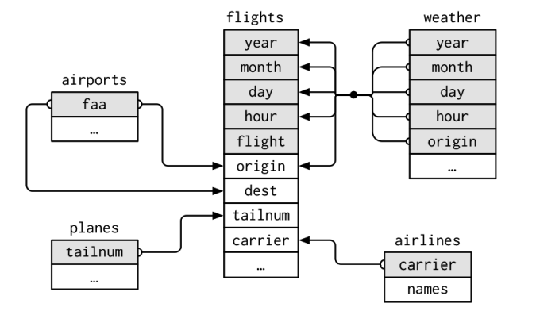
join()
it with another data frame by matching along a “key” variable. In other words, merge these two data frames together

Slide 18
Join types
Inner join: retain (only) observations where this is a match in both datasets (left and right)
Left join: Keep all rows in left-hand dataset, add values from right-hand dataset where there is a match.
Right join: Keep all rows in right-hand dataset, add values from left-hand dataset where there is a match. For non-matching observations on the left, fill in NA
Full join: Combine observations from both datasets based on matching key and fill in NA for non-matches.

Slide 19


Example:
Single key join
Multiple key join

Slide 20
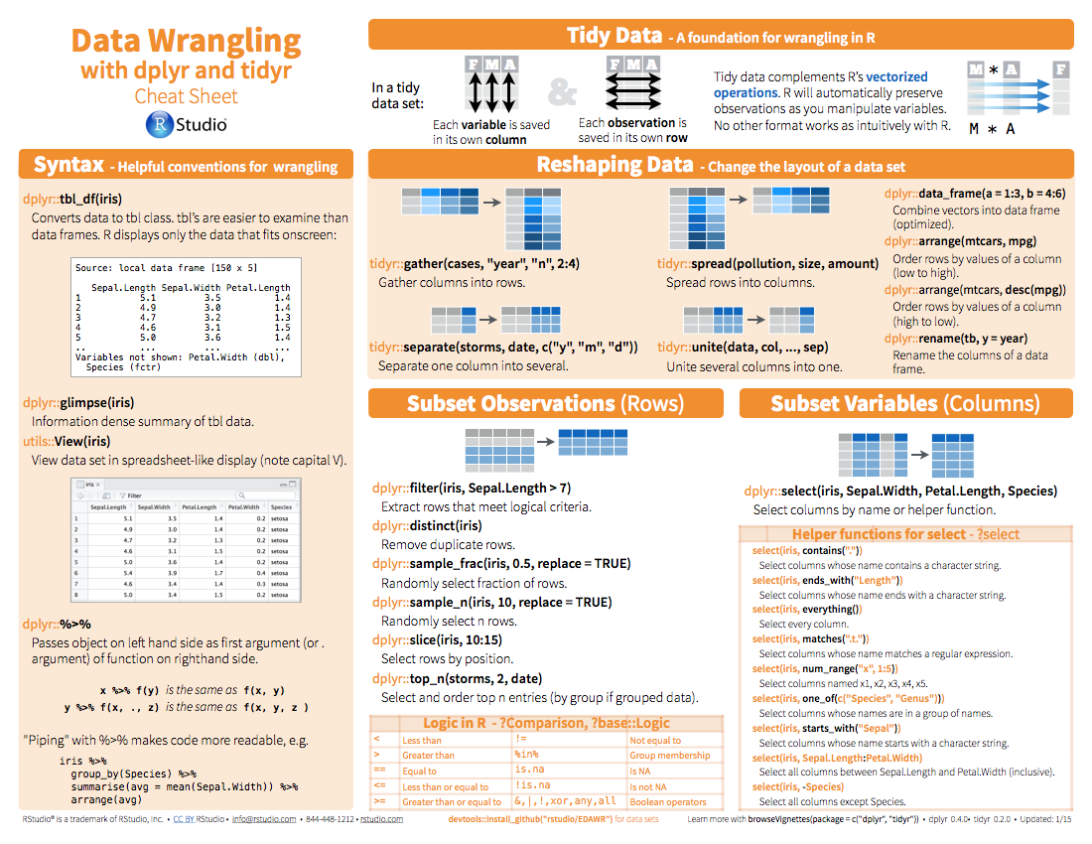
CheatSheets
https://www.rstudio.com/resources/cheatsheets/)

Slide 21
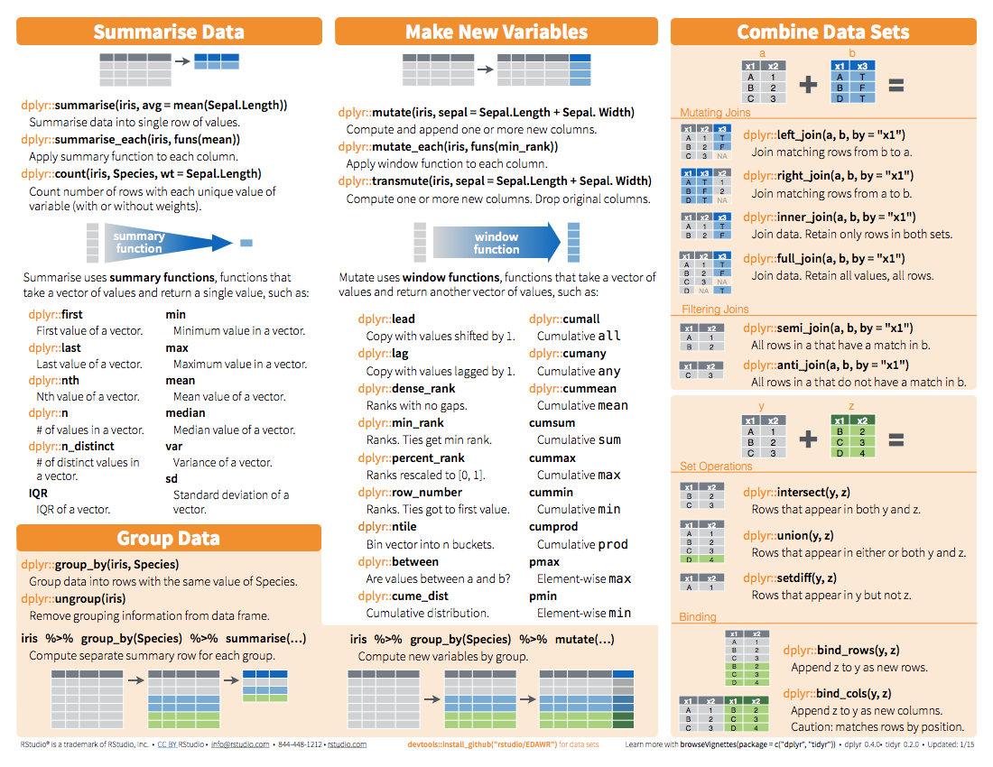
Rstudio>help>CheatSheets

